Slide 1
Reinforcement Learning

Slide 2
Outline
Introduction
How does Reinforcement Learning Work?
Process of RL
Exploration-exploitation trade-off
Core Components of RL
Online vs offline learning
Applications of Reinforcement Learning
Example

Slide 3
Reinforcement Learning - Introduction
Reinforcement Learning (RL) is the science of decision making.
It is about learning the optimal behavior in an environment to obtain maximum reward.
This optimal behavior is learned through interactions with the environment and observations of how it responds, similar to children exploring the world around them and learning the actions that help them achieve a goal.

Slide 4
Reinforcement Learning - Introduction
In the absence of a supervisor, the learner must independently discover the sequence of actions that maximize the reward.
This discovery process is akin to a trial-and-error search.
The quality of actions is measured by not just the immediate reward they return, but also the delayed reward they might fetch.
As it can learn the actions that result in eventual success in an unseen environment without the help of a supervisor, reinforcement learning is a very powerful algorithm.

Slide 5
How Does Reinforcement Learning Work?
Reinforcement Learning revolves around the idea that an agent (the learner or decision-maker) interacts with an environment to achieve a goal.
The agent performs actions and receives feedback to optimize its decision-making over time.
Agent: The decision-maker that performs actions.
Environment: The world or system in which the agent operates.
State: The situation or condition the agent is currently in.
Action: The possible moves or decisions the agent can make.
Reward: The feedback or result from the environment based on the agent’s action.

Slide 6
Reinforcement Learning Process
Agent
Reward R(t)
Action A(t)
State S(t)
Environment

Slide 7
Reinforcement Learning Process
The reinforcement learning agent learns about a problem by interacting with its environment.
The environment provides information on its current state.
The agent then uses that information to determine which actions(s) to take.
If that action obtains a reward signal from the surrounding environment, the agent is encouraged to take that action again when in a similar future state.
This process repeats for every new state thereafter.
Over time, the agent learns from rewards and punishments to take actions within the environment that meet a specified goal

Slide 8
Exploration-exploitation trade-off
Because an RL agent has no manually labeled input data guiding its behavior, it must explore its environment, attempting new actions to discover those that receive rewards.
From these reward signals, the agent learns to prefer actions for which it was rewarded in order to maximize its gain.
But the agent must continue exploring new states and actions as well. In doing so, it can then use that experience to improve its decision-making.
The agent cannot exclusively pursue exploration or exploitation.
It must continuously try new actions while also preferring single (or chains of) actions that produce the largest cumulative reward.

Slide 9
Core Components
Let's see the core components of Reinforcement Learning
1. Policy
Defines the agent’s behavior i.e maps states for actions.
Can be simple rules or complex computations.
Example: An autonomous car maps pedestrian detection to make necessary stops.
2. Reward Signal
Represents the goal of the RL problem.
Guides the agent by providing feedback (positive/negative rewards).
Example: For self-driving cars rewards can be fewer collisions, shorter travel time, lane discipline.

Slide 10
Core Components
3. Value Function
Evaluates long-term benefits, not just immediate rewards.
Measures desirability of a state considering future outcomes.
Example: A vehicle may avoid reckless maneuvers (short-term gain) to maximize overall safety and efficiency.
4. Model
Simulates the environment to predict outcomes of actions.
Enables planning and foresight.
Example: predicting other vehicle’s movements to plan safer routes.

Slide 11
Working of Reinforcement Learning
The agent interacts iteratively with its environment in a feedback loop:
The agent observes the current state of the environment.
It chooses and performs an action based on its policy.
The environment responds by transitioning to a new state and providing a reward (or penalty).
The agent updates its knowledge (policy, value function) based on the reward received and the new state.
This cycle repeats with the agent balancing exploration (trying new actions) and exploitation (using known good actions) to maximize the cumulative reward over time.

Slide 12
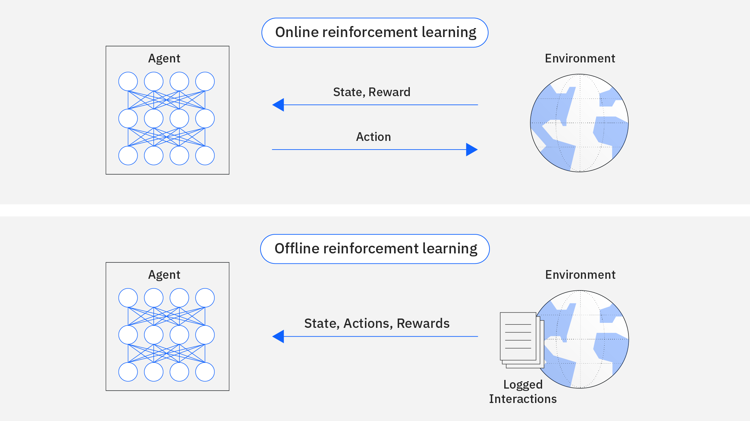
Online versus offline learning
Online Learning:-
Here, an agent collects data directly from interacting with its surrounding environment.
This data is processed and collected iteratively as the agent continues interacting with that environment.

Slide 13
Online versus offline learning
Offline Learning:-
When an agent does not have direct access to an environment, it can learn through logged data of that environment.
This is offline learning.
A large subset of research has turned to offline learning given practical difficulties in training models through direct interaction with environments.

Slide 14
Examples of Reinforcement Learning Applications
Robotics and Automation
Autonomous Vehicles
Healthcare
Finance & Trading
Gaming & Entertainment
Natural Language Processing
Personalized Recommendation Systems
Industrial Control Systems
Energy & Resource Management
Education & Training

